Slide 1
Euro Heart Index 2016
Brussels, December 7, 2016
Dr. Beatriz Cebolla
Prof. Arne Björnberg
Prof. Ian Graham
Prof Dan Gaita
info@healthpowerhouse.com

Slide 2

Cast, in the order of appearance
Prof. Arne Björnberg, Chairman HCP Ltd., Marseillan, France
Dr. Beatriz Cebolla, Project Director, Euro Heart Index 2016, Cologne, Germany
Prof. Ian Graham, Cardiovascular Medicine, Trinity College, Dublin, Secretary/Treasurer of the European Society of Cardiology
Prof. Dan Gaita, FESC, Timisoara, Romania, President of CardioPrevent Foundation, Board Member of European Heart Network

Slide 3

Health Consumer Powerhouse
Comparing healthcare system performance in 35 countries from a consumer/patient view.
Since 2004, ~50 index editions, available for free.
Index projects financed through unconditional development grants, similar to medical faculty sponsored research.
Europe
Euro Health Consumer Index 2005, 2006, 2007, 2008, 2009, 2012, 2013, 2014, 2015, 2016
Euro Consumer Heart Index 2008, 2016
Euro Diabetes Care Index 2008, 2014
Euro HIV Index 2009
Euro Patient Empowerment Index 2009
Nordic COPD Index 2010
Tobacco Harm Prevention Index 2011
Euro Headache Index 2011
Euro Hepatitis Index 2012
Euro Vision Scorecard 2013
Euro Pancreatic Cancer Index 2014
Sweden, others
Health Consumer Index Sweden 2004, 2005, 2006
Diabetes Care Index Sweden 2006, 2007, 2008
Breast Cancer Index Sweden 2006
Vaccination Index Sweden 2007, 2008
Renal Care Index Sweden 2007, 2008
Smoke Cessation Index Sweden 2008
COPD Index Sweden 2009, Nordic 2010
Advanced Home Care Index Sweden 2010
Euro-Canada Health Consumer Index Canada 2008, 2009
Provincial Health Consumer Index Canada 2008, 2009, 2010
All Hospitals Index Sweden 2011

Slide 4
The Euro Heart Index is….
A tool to empower patients and physicians by reviewing and comparing health care provision and policies for heart care in all EU member states, Switzerland and Norway.
Increase transparency and comparability of healthcare systems
Increase public awareness, create discussion and indicate strong and weak aspects of each national healthcare system (pointing successful examples)
Helping European citizens to improve the services they receive.
Notes:
4

Slide 5
Content and construction of the EHI 2016
1. Indicator selection
2. Data Collection
(Soft data and hard data))
Sub-discipline | Number of indicators
1. Prevention | 10
2. Procedures | 11
3. Access to treatment/care | 6
4. Outcomes | 4
Country | Responded | Country | Responded
Austria | √ | Latvia | √
Belgium |  | Lithuania
Bulgaria | √ | Luxembourg | √
Croatia | √ | Malta | √
Cyprus | √ | Netherlands | √
Czech Republic |  | Norway | √
Denmark | √ | Poland
Estonia |  | Portugal | √
Finland | √ | Romania | √
France |  | Slovakia | √
Germany | √ | Slovenia | √
Greece | √ | Spain | √
Hungary | √ | Sweden
Ireland | √ | Switzerland | √
Italy | √ | United Kingdom | √
3. Scoring
4. Validation
Score 3 C | Score 2 F | Score 1 D

Slide 6
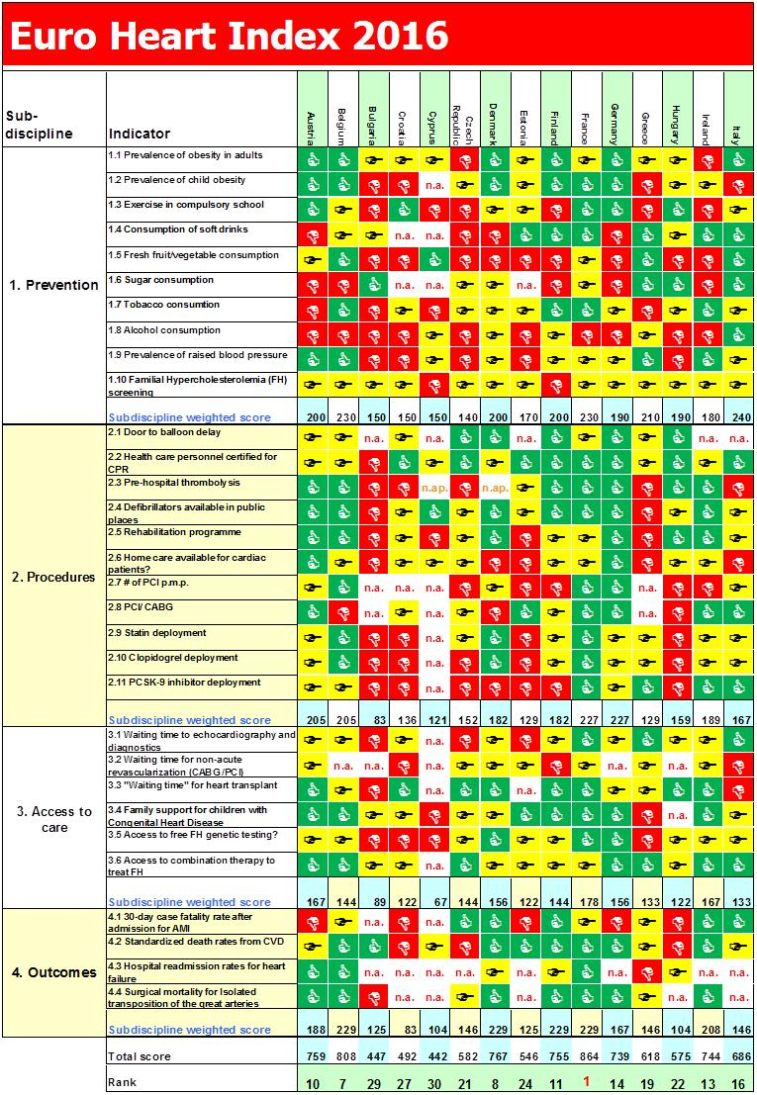

Slide 7
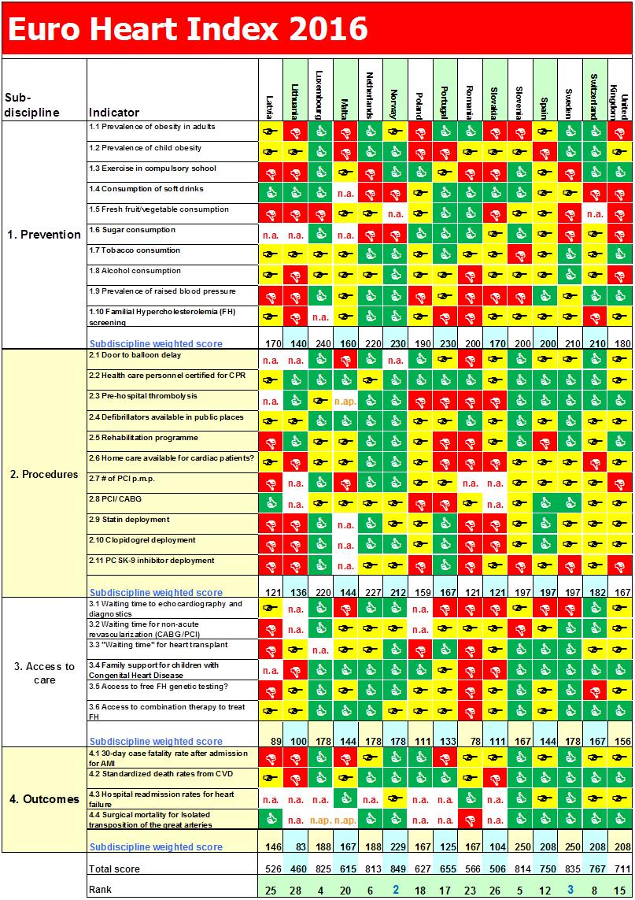

Slide 8
CVD situation in Europe
Globally, an estimated 17.5 million people died from CVDs in 2012, representing 31% of all deaths, over 80 % of which take place in low-and middle-income countries. Today, CVDs is the largest single contributor to global mortality.
In Europe, CVD causes more than 2 million deaths every year
CVD remains the main cause of death in most countries but has already been overtaken by cancer in 12 countries
CVD is a big threat economically and socially.
CVD has become an important focus of the European Union and the national health bodies in the last decade. A high number of programmes and initiatives have been funded and implemented all over the region to improve the situation. European and national organisations have been creating guidelines, education, programmes and policy recommendations to promote standards and pathways.
CVD can be prevented
Most risk factors associated with CVD are modifiable.

Slide 9
Primary Prevention
  Obesity
  Sedentary lifestyle/Physical activity
  Vegetables and fruit consumption
  Sugar consumption
  Tobacco
  Alcohol
Notes:
obesity, diabetes, smoking, unhealthy diet, sedentary lifestyle, stress, or excessive alcohol intake etc. Prevention in the general population is essential to reduce the burden of CVD.

Slide 10
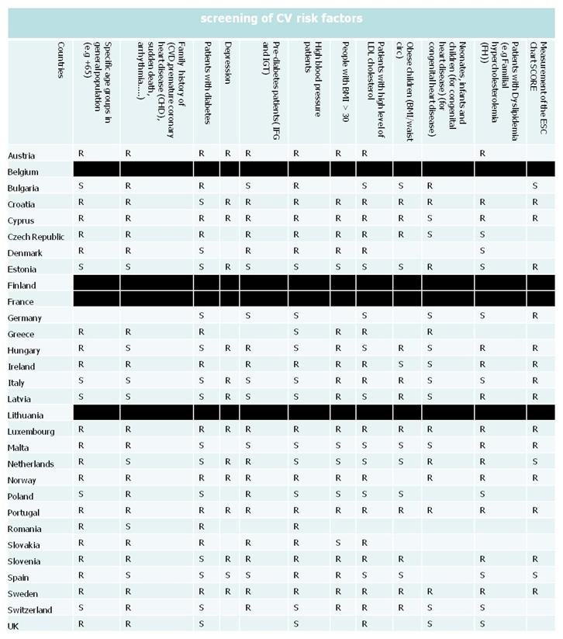
Screening of CVD risk factors (Risk population)
GPs and primary care health workers are key players for detection and primary prevention
Notes:
Additionally, risk populations need to get regular follow ups for CVD risk factors. Education is needed to empower patients and make them understand the importance of life style changes, take the suggested medication and when to seek care.

Slide 11
Awareness campaigns and education about healthy life style
(promoting healthy habits)
Population at risk
General population
Primary care physicians,
community workers,
teachers and educators.

Slide 12
Structural/regulatory
Limit marketing of unhealthy food for children
Addressing food composition
Tobacco control laws and tobacco control interventions
Alcohol control laws, taxation ect....

Slide 13
Procedures
  Coordination and integration between services (Primary and secondary care)
  In emergency situations, good coordination and efficient communication process after an emergency call with emergency services and ambulances.
  Enough resources depending on national situation, such as sufficiently trained cardiologists and cardiothoracic surgeons per capita, PCI centres, Catheterization labs.....
  Data Collection.
Notes:
Good coordination and integration between services and especially between primary and secondary care resulting in reduced waiting time for diagnostic procedures and revascularization treatment. All patients should have timely access to an appropriate range of diagnostic procedures, therapies and long-term follow-up care.
In emergency situations, good coordination and efficient communication process after an emergency call with emergency services and ambulances, are essential for timely services to improve outcomes. Door to balloon time (D2B), the time from the arrival of an ST-elevation myocardial infarction (STEMI) patient at a hospital to the time of percutaneous coronary intervention (PCI). National and international guidelines recommend that in emergency treatment of patients with STEMI, primary PCI should be performed within 90 minutes of arrival at the heart attack centre and within 120 minutes of a patient’s call for professional help (call-to-balloon time). Most countries, at least those with data available, reach that target. The D2B time has been reduced enormously, in many countries by half, in recent years.
Enough resources depending on national situation, such as sufficiently trained cardiologists and cardiothoracic surgeons per capita. Priority to fund primary PCI centres with cardiac catheterization labs, with sufficiently trained staff, which are easily accessible at all hours (24/7) is demonstrated that have a deep impact on mortality rates. In general, primary PCI use is increasing very quickly in Europe but huge gaps remain. The number of primary (non-stop) PCI centres is still very uneven between countries. In some countries, and even more in some regions, in Europe it is still difficult to access services 24/7.

Slide 14
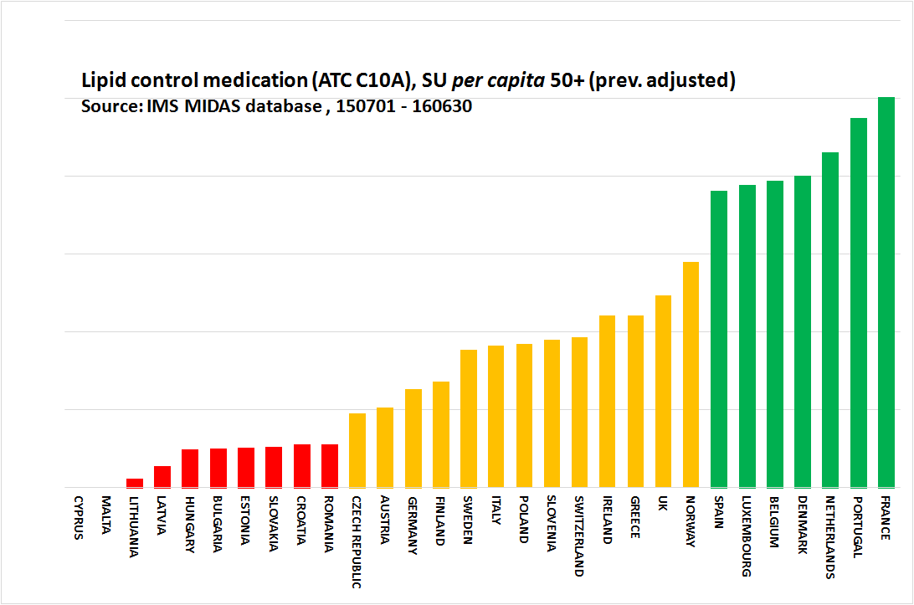
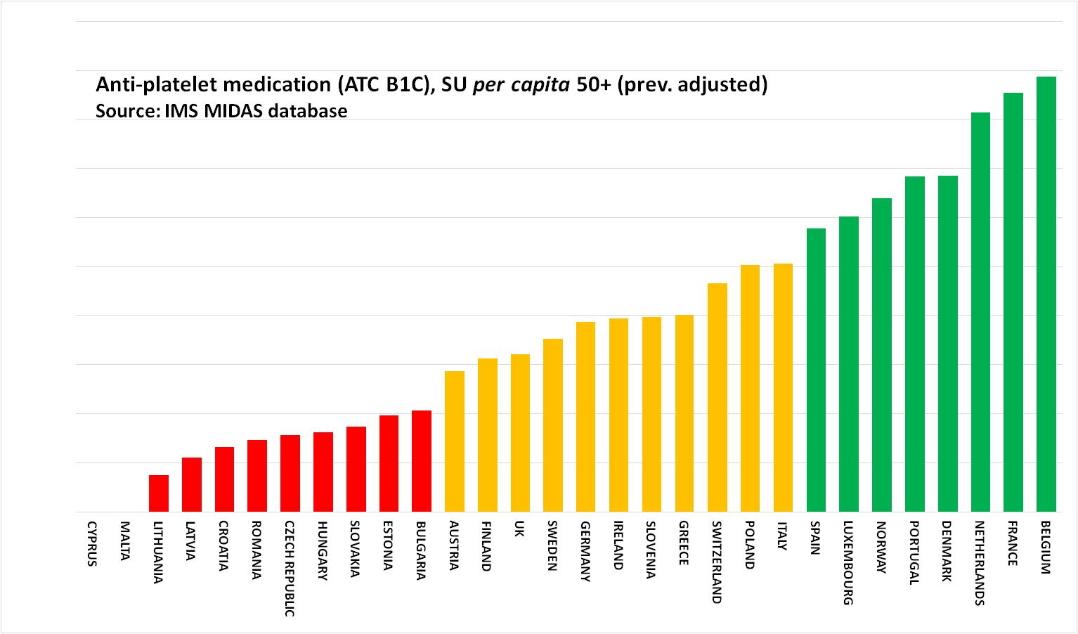
Access to Medication
Statin deployment
Clopidogrel deployment
Notes:
There is a large between-country variation of clopidogrel and statin utilization. Both classes of drugs are essential, cheap and generic. However, their use differs widely between European countries. Apparently, there are a number of factors that determine the different utilization of these drugs, such as different national guidelines, reimbursement policies or professional culture. What is food for thought (see Indicators 2.9 and 2.10) is that the deployment rates of these drugs shows less variation between countries if calculated per capita, without adjustment for CVD prevalence; i.e. they are prescribed more uniformly per capita of the general public than per capita for heart patients!

Slide 15
Access
Funding
Secondary prevention
Data for primary vs. secondary prevention
Notes:
Secondary prevention
It is still not quite understood that secondary prevention is a very important step to improve outcomes and reduce hospital readmission after any heart condition. Patients need to get involved in a personal assessment and modification of risk factors program, and purpose-designed exercise programs. Education and support for individual patients, their families and caregivers should be given as well as counselling, behaviour modification strategies and support for self-management. Patients should have regular follow ups with general practitioners (GPs) and specialists. All the above mentioned should be included in post-event rehabilitation. In Europe, access to rehabilitation is quite limited, often because is not or only partially reimbursed. The quality, the length and the content of the programs available are very diverse.

Slide 16
CVD registries/Data
Public data missing on important indicators (Procedures and outcomes). Important data only on hospital level.
Data on prevention difficult to separate (general population, CVD patients)
Not comparable data
Some data is collected with slightly different definitions by different organisations.
Difficulties to access data
Notes:
The explosion of cardiovascular registries during the past 2 decades has been remarkable. Currently, there are national CVD registries and databases operational in a number of member states. To date, clinical registries of cardiovascular disease have been pre-dominantly founded in high income Western countries.
There is still public data missing on important indicators, particularly measuring performances in procedures and outcomes. Even those existing registries are not always completed or have the optimal quality, often only patchy set of data are available. When the data exists it is often difficult to access, not only from national registries but also data collections from international organisations. Only in those countries like Sweden or the UK where results are regularly published in open sources, the is data easy to find.
Compared with other disease areas, data standards and definitions are better established. Still, important indicators show several “n.a.” (not available) scores due to differences in data standards and methods of collection and recording employed in the different member states, yielding not comparable data (e.g. D2B data or readmission rates).
Some data is collected with slightly different definitions by different organisations, duplicating work for those providing the data. On the other hand, there is important data only recorded on the hospital level.
It is important to measure performances in the region to enable decisions based on robust, global, evidence-based clinical recommendations in order to improve quality of care. For example; in many guidelines, a large proportion of recommended treatments have a level of evidence C, which means that the recommendation is purely based on consensus of the members of the guidelines committee and that reliable data on the recommended diagnostic modalities or treatments are not available in spite of the fact that they are given routinely to many patients.^{[1]}
There is a tendency to compare Europe to USA, but it is also vital to understand the situation within Europe, and how individual countries are performing.

Slide 17
Familial hypercholesterolemia care in Europe
Hereditary, metabolic, autosomal (affecting both sexes the same) dominant disorder.
Characterized by abnormally high total cholesterol (TC) and low-density lipoprotein cholesterol (LDL-C) levels. FH is a common genetic cause of premature coronary heart disease.
There is a large number of Europeans suffering from FH. Many of them do not know, as they are still undiagnosed and therefore left untreated.
FH is a disease that is rather easy and cheap to treat.

Slide 18
FH case finding
Screening of family members of FH patients
Genetic testing for FH subsidised

Slide 19
Official recommendations or guidelines, approved by the government,
in place in regarding treatment and/or screening of FH
Any activities or campaigns with public funding during the last two years
to increase awareness

Slide 20
Access to FH treatment
Subsidized /reimbursement of combination therapy (statin plus ezetimibe)

Slide 21
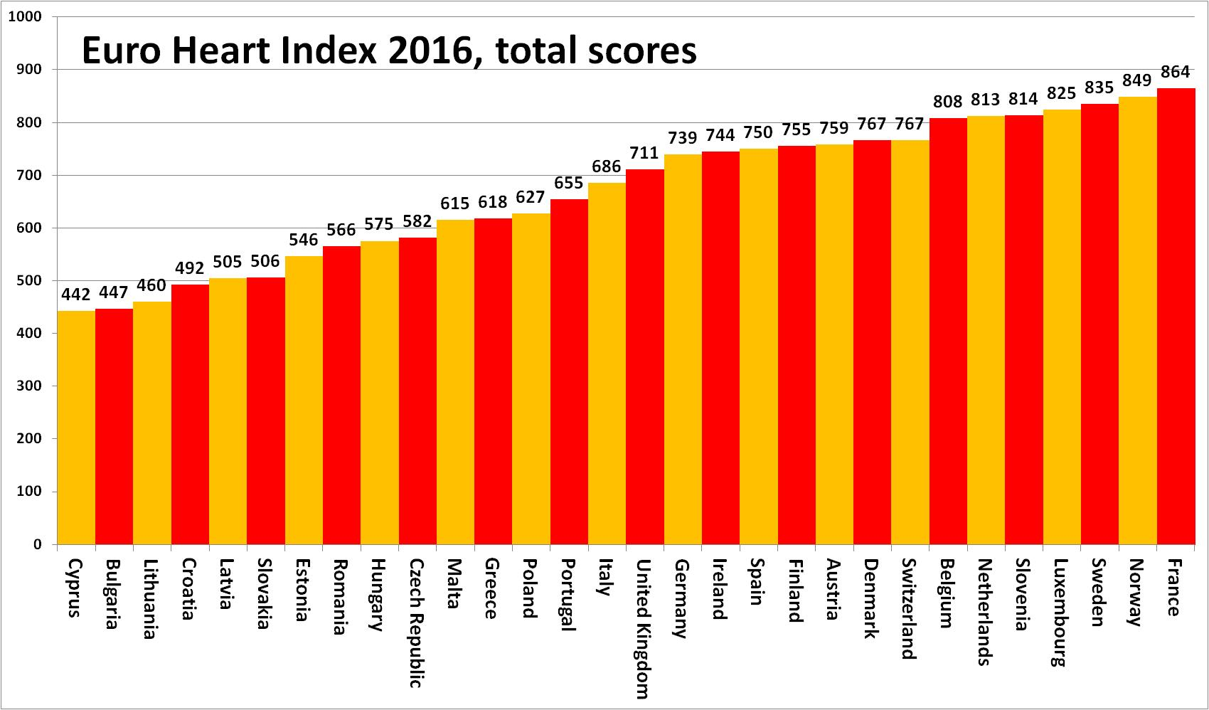

Slide 22
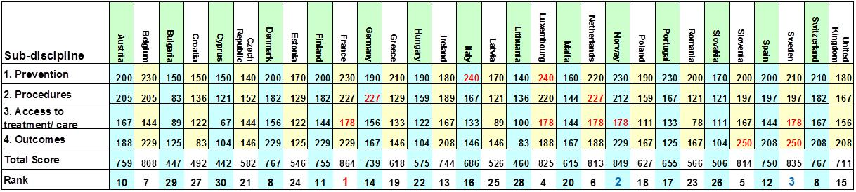
Top performers in the Index. What are they doing well?
Sub-discipline | Top country/countries | Top Scores | Maximum score
1. Prevention | Italy, Luxembourg | 240 | 300
2. Procedures | Germany, Netherlands | 227 | 250
3. Access to treatment/care | France, Luxembourg, Netherlands, Norway, Sweden | 178 | 200
4. Outcomes | Slovenia, Sweden | 250 | 250

Slide 23
THANK YOU -
SEE IT ALL ON www.healthpowerhouse.com

Slide 24
MORE SLIDES

Slide 25
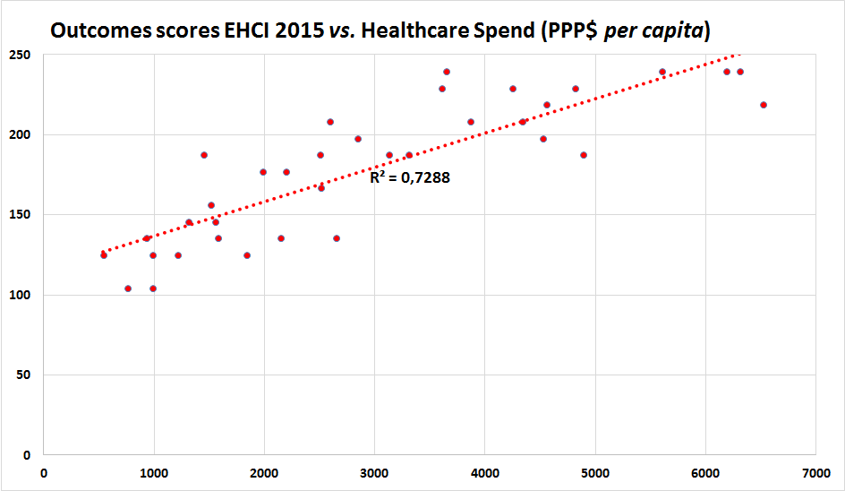
Money does buy better Treatment Results
PL

Slide 26
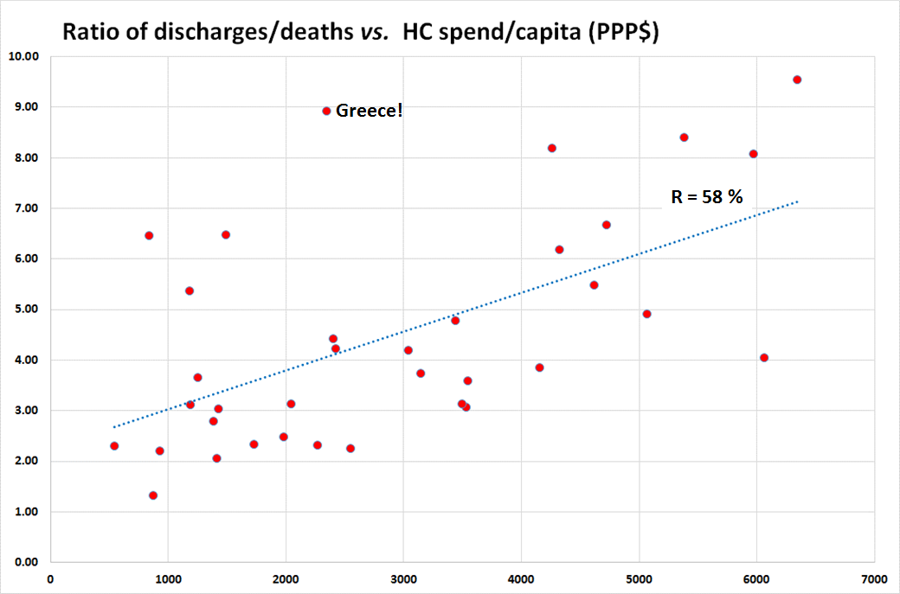
An example of a LAP Indicator; ”Level of Attention to the Problem”.
Wealthy countries can afford admitting patients on weaker indications,
but there are deviations!
Greek hospitals have press gangs
roaming city streets?

Slide 27
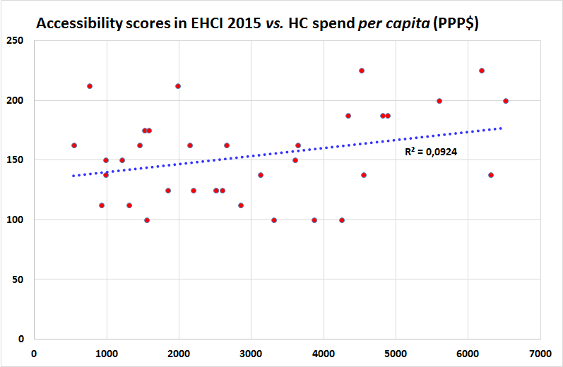
Money does not necessarily buy better access to healthcare …
BE
CH
MK
CZ
PL
UK
IE
SE
for the rather fundamental reason that it is cheaper to operate a healthcare system without waiting lists!

Slide 28
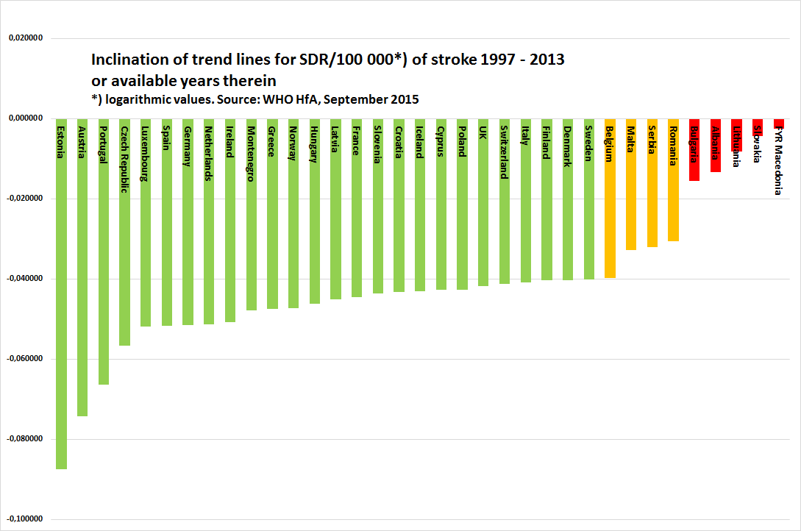
Treatment results keep improving!
The large number of Green scores is because
cut-offs were kept from 2014, when several countries were below the Green cut-off.

Slide 29
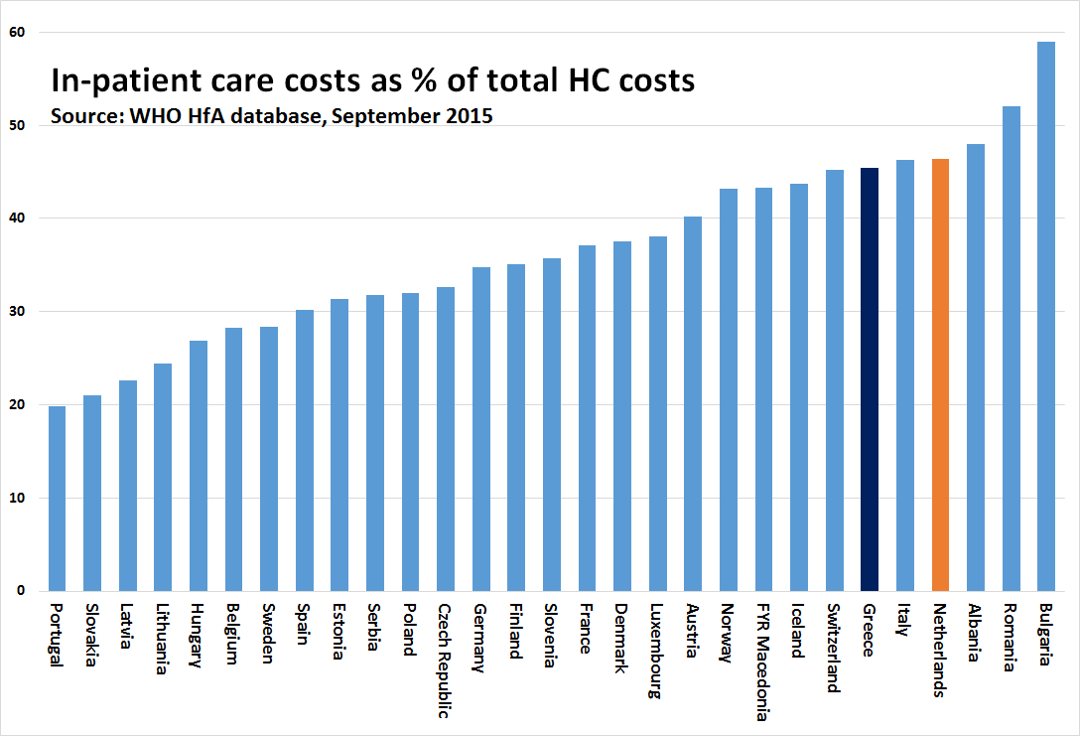
”Structural Antiquity” Index for healthcare systems

Slide 30
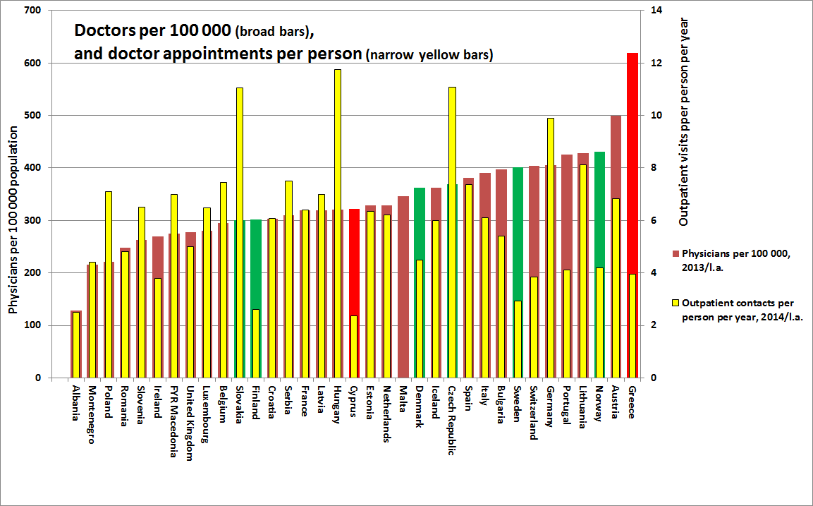
Accessibility not really related to number of doctors!

Slide 31
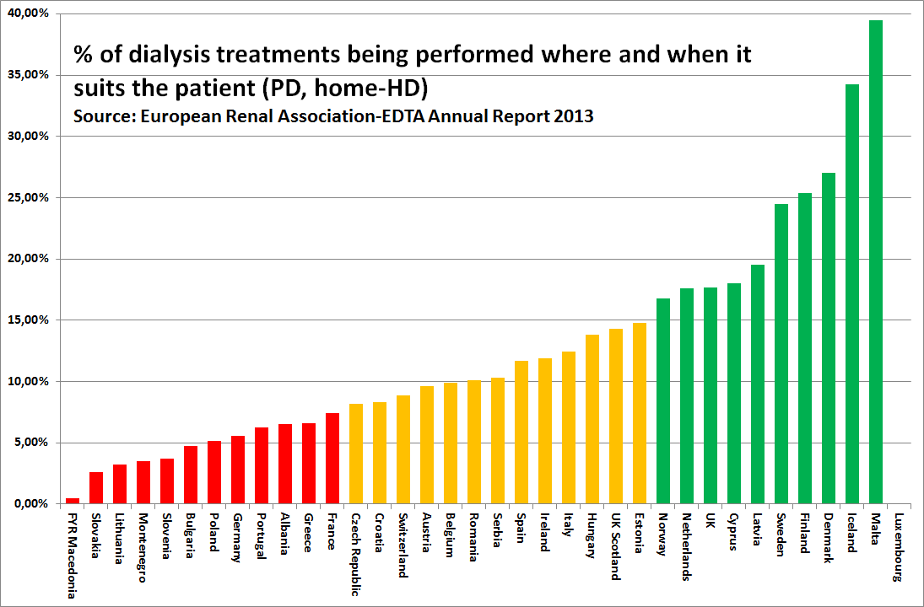
Sometimes money buys worse healthcare
Clinic dialysis is over-remunerated, and
home dialysis is under-remunerated?

Slide 32
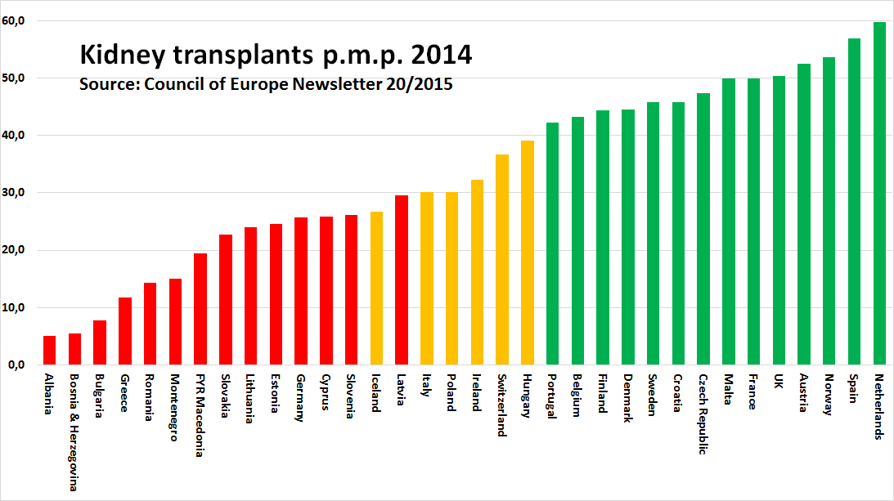
Sometimes money buys even worse healthcare!
Are there other reasons for the low German transplant rate
than the profitability of clinic dialysis?

Slide 33
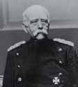
”Bismarck Beats Beveridge”
Bismarck systems dominate the top of EHCI ranking
  Beveridge systems offer conflicts between loyalty to citizens and loyalty to healthcare system/organisation (“politician home town job preservation”)
  lack of business acumen in Beveridge systems; efficiency gains and cutbacks frequently not differentiated!
  small Beveridge systems (the Nordic countries) can compete
“Chaos” systems do better than centrally planned
  100’s of thousands of professionals take better decisions and drive development better than central bodies
  incentives driving quality and productivity are essential!

Slide 34
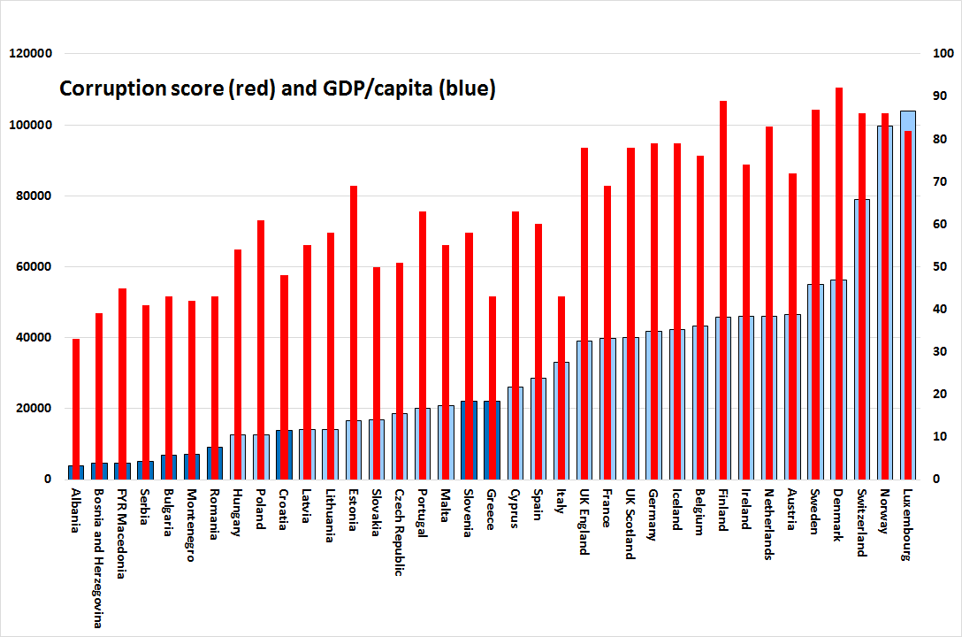
Poland not too corrupt!

